Slide 1
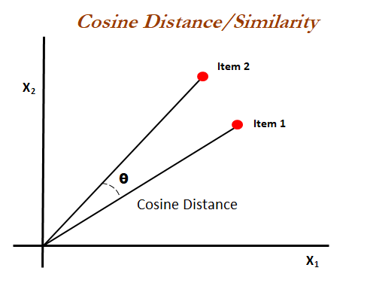
Cosine Similarity - Intro
The most basic approach to find the similarity between two documents is counts the number of similar words, known as Euclidean distance. This is flawed when the sizes of documents are far apart.
Cosine Similarity measure can overcome the euclidean distance flaw.
Cosine similarity is a similarity metric that is used to measure the similarity between documents irrespective of the size.
The Cosine similarity is the measure of angle between the documents projected as vectors over a multidimensional space.

Slide 2
Cosine Similarity - Working
The cosine similarity begins with finding the cosine of two non zero vectors. This can be derived by using the Euclidean dot product formula as given below
With the dot product of the vectors the Cosine similarity is given as
The output will range from -1 to 1 where ‘-1’ is non-similar ‘0’ is orthogonal(perpendicular) and ‘1’ is similar.

Slide 3
Cosine Similarity - Example
Doc 1 : Deep Learning can be hard
Doc 2: Deep Learning can be simple
Word | Doc 1 (word count) | Doc 2 (word count)
Deep | 1 | 1
Learning | 1 | 1
Can | 1 | 1
Be | 1 | 1
Hard | 1 | 0
Simple | 0 | 1

Slide 4
Cosine Similarity - Example (Contd.)
Doc 1: [1, 1, 1, 1, 1, 0], assume as ‘A’
Doc 2: [1, 1, 1, 1, 0, 1], assume as ‘B’
Finding the Dot product (A . B): 1.1 + 1.1 + 1.1 + 1.1 + 1.0 + 0.1 = 4
Magnitude of A : √1² + 1² + 1² + 1² +1² + 0² = 2.2360679
Magnitude of B : √1² + 1² + 1² + 1² +0² + 1² = 2.2360679
Similarity : (4) / ( 2.2360679 x 2.2360679 ) = 0.8
The given documents have 80% similarity.

Slide 5
Cosine Similarity - Applications
Cosine Similarity has a variety of applications in Data Science.
Plagiarism detectors
Recommendation systems
Information retrieval
Text matching
It can be also used as loss function while training neural networks.
Cosine Similarity is good because even if the documents are far apart by size they might inclined towards each other (angle between them is low) having high similarity.

