Slide 1
ACTION RULES

Slide 2
What is Action rule ?
An action rule is a rule that describes a transition between one state and another.with respect to distinguished attribute called a decision attribute .
Action rule can be represented with the formula
[(ω) ∧ (α → β)] →(ϕ→ψ)
(ω) - conjunction of fixed proportion shared by both the groups.
(α → β)-proposed changes in values of flexible features.
(ϕ→ψ)- desired effect of action
[(ω) ∧ (α → β)] →(ϕ→ψ)
[(ω) ∧ (α → β)] →(ϕ→ [(ω) ∧ (α → β)] →(ϕ→ψ)
[(ω) ∧ (α → β)] →(ϕ→ψ)

Slide 3
Validation of rule pairs
There are various approaches to check if a pair of classifications rules satisfies the conditions.
One of these approaches is the baseline approach, where the same stable attribute must be present in both sets of rules. The values of the target attribute must also be the same.
For instance, if the target attribute is "No to Survival", then the action rules should change the target state to "Yes".
more action rules, because they allow to generate candidates even if the input classification rules don't contain missing values.

Slide 4
Generation of action rule
In the following, we will talk about the phases of the rule-based approach to generate action rules. The algorithm tries to find pairs of classification rules that can be used to generate rules.
The target variable is also divided into two columns. The first one shows the conditions that are stable and flexible. The second one shows the rules that can be used to generate action rules.
The first and second tables have classification rules that contain the desired state. These rules are created as a pair of classification rule pairs that are suitable for action rules.
The action rule candidate is then formed from a rule that predicts the class state before and a rule that predicts the class state after.

Slide 5
Implementation
The Action Rules package can be executed in two different ways: the complete mining workflow or the action rule generation phase.
Action rules package can be installed with the following command
pip install actionrules-lukassykora
The package for action rules mining uses PyFIM5 library as a default option for classification rule discovery. The PyFIM package returns an exhaustive list of classification rules used as input for action rule generation. The Action Rules package uses the same general machine learning workflow as Scikit-Learn [1], a popular data mining library.

Slide 6
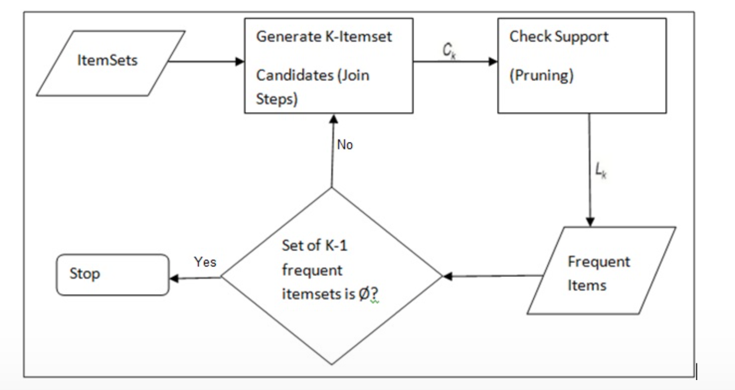
Generating frequent action sets (apriori)

Slide 7
Thank you

