Slide 1

Validating Action Rules

Slide 2

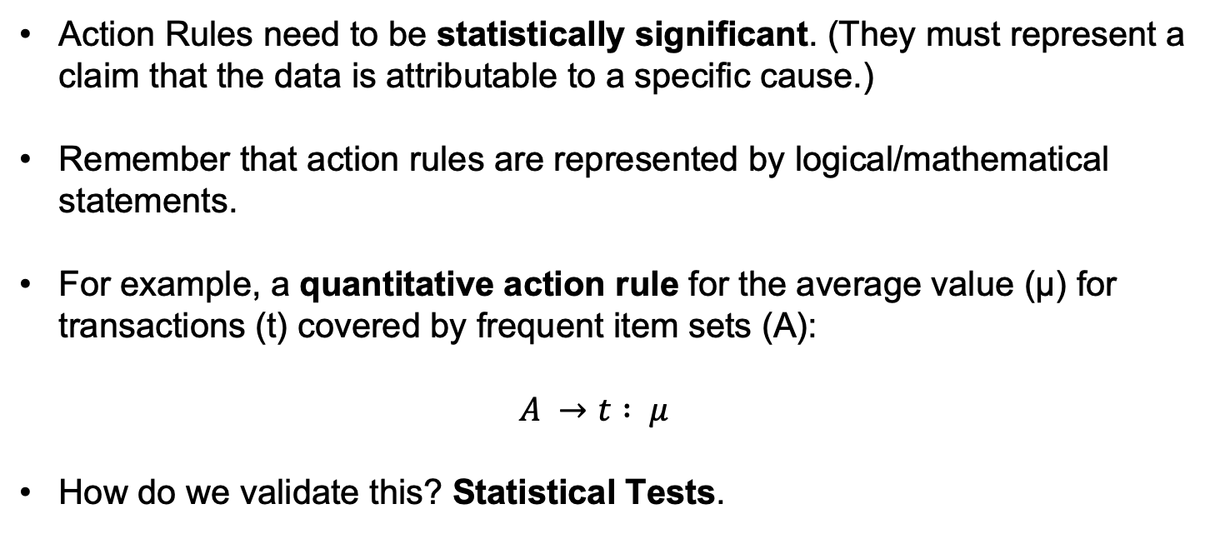
Why Validate Action Rules?
  Action Rules need to be statistically significant. (They must represent a claim that the data is attributable to a specific cause.)
    Remember that action rules are represented by logical/mathematical statements.
    For example, a quantitative action rule for the average value (µ) for transactions (t) covered by frequent item sets (A):
    $A →t : μ$
    How do we validate this? Statistical Tests.

Slide 3
A Brief Refresher on Statistics
A Z-value represents the statistical significance.
µ (Mu) represents the mean (average) value in a dataset A that meet our condition (action rule).
µ′ (Mu prime) represents the mean (average) value in a dataset A that does NOT meet our condition (action rule).
Δ (Delta) represents a user defined threshold used in testing our rule.

Slide 4
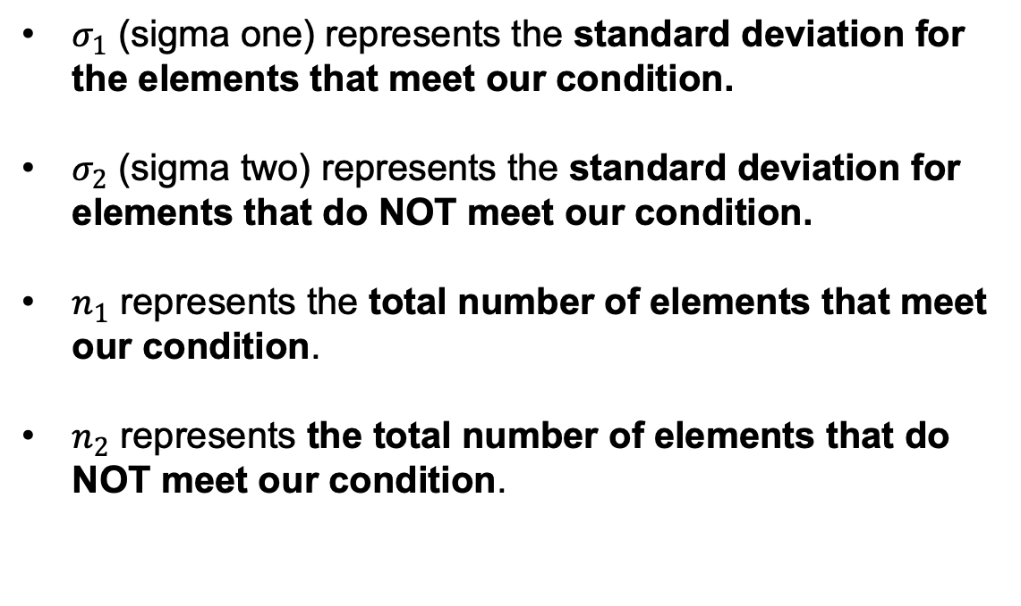
A Brief Refresher on Statistics (cont.)
$σ_{1}$ (sigma one) represents the standard deviation for the elements that meet our condition.
$σ_{2}$ (sigma two) represents the standard deviation for elements that do NOT meet our condition.
$n_{1}$ represents the total number of elements that meet our condition.
$n_{2}$ represents the total number of elements that do NOT meet our condition.

Slide 5
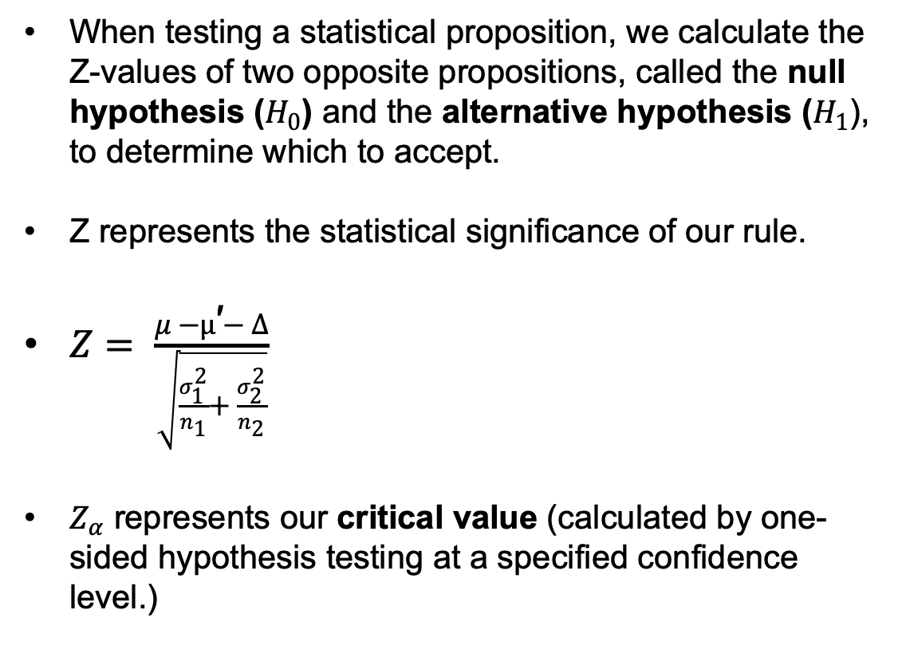
Bringing it all together
When testing a statistical proposition, we calculate the Z-values of two opposite propositions, called the null hypothesis ($H_{0}$) and the alternative hypothesis ($H_{1}$), to determine which to accept.
Z represents the statistical significance of our rule.
$Z= \frac{μ −µ\text{′}− Δ}{\sqrt{\frac{σ_{1}^{2}}{n_{1}}+ \frac{σ_{2}^{2}}{n_{2}}}}$
$Z_{α}$ represents our critical value (calculated by one-sided hypothesis testing at a specified confidence level.)

Slide 6
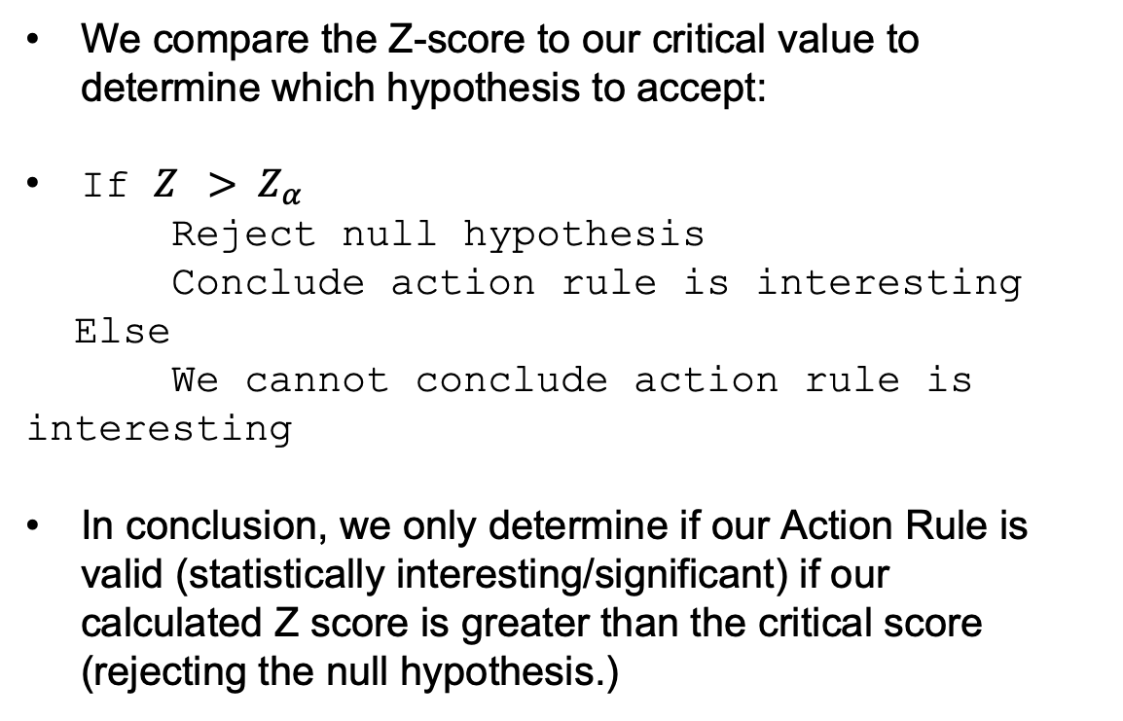
What do I do with my Z-scores?
We compare the Z-score to our critical value to determine which hypothesis to accept:
If ${Z > Z}_{α}$
Reject null hypothesis
Conclude action rule is interesting
Else
We cannot conclude action rule is interesting
In conclusion, we only determine if our Action Rule is valid (statistically interesting/significant) if our calculated Z score is greater than the critical score (rejecting the null hypothesis.)

Slide 7
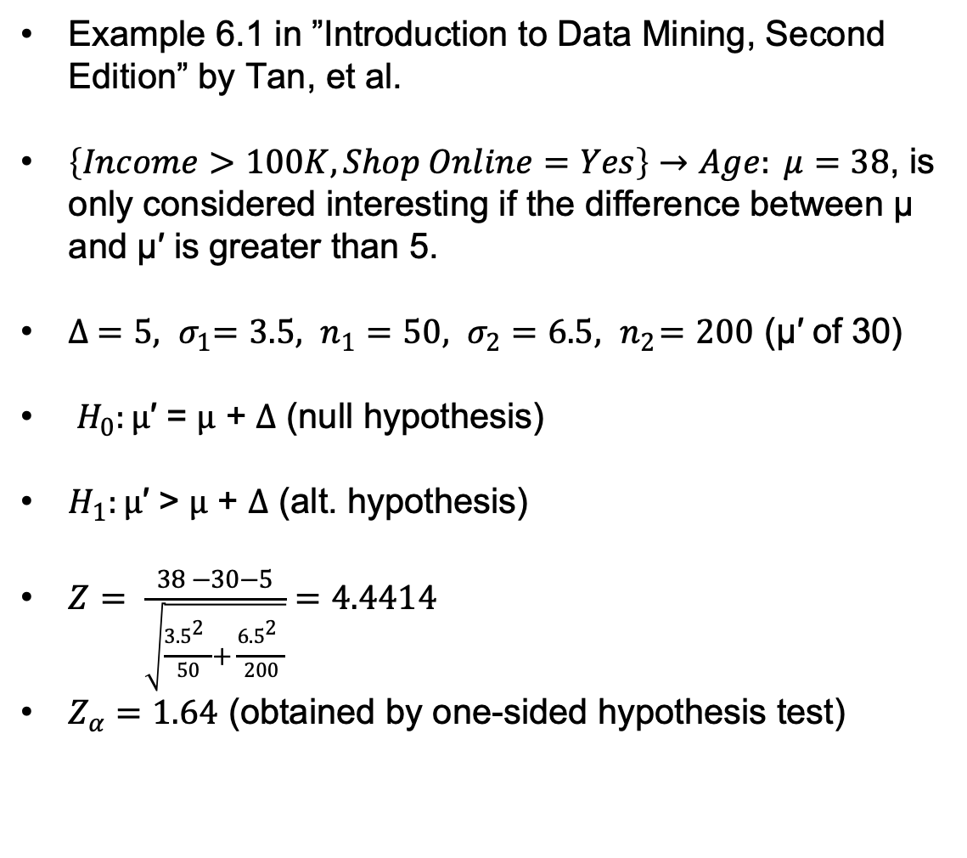
A concrete example
Example 6.1 in ”Introduction to Data Mining, Second Edition” by Tan, et al.
$\left\{Income>100K, Shop Online=Yes\right\}→Age: μ=38$, is only considered interesting if the difference between µ and µ′ is greater than 5.
${{∆ =5, σ}_{1}=3.5, n}_{1}=50, σ_{2}=6.5, { n}_{2}=200$ (µ′ of 30)
$H_{0}:µ\text{′ = }μ\text{ + }Δ$ (null hypothesis)
$H_{1}:µ\text{′ > }μ\text{ + }Δ$ (alt. hypothesis)
$Z= \frac{38 −30−5}{\sqrt{\frac{{3.5}_{}^{2}}{50}+ \frac{{6.5}_{}^{2}}{200}}}=4.4414$
$Z_{α}=1.64$ (obtained by one-sided hypothesis test)

Slide 8
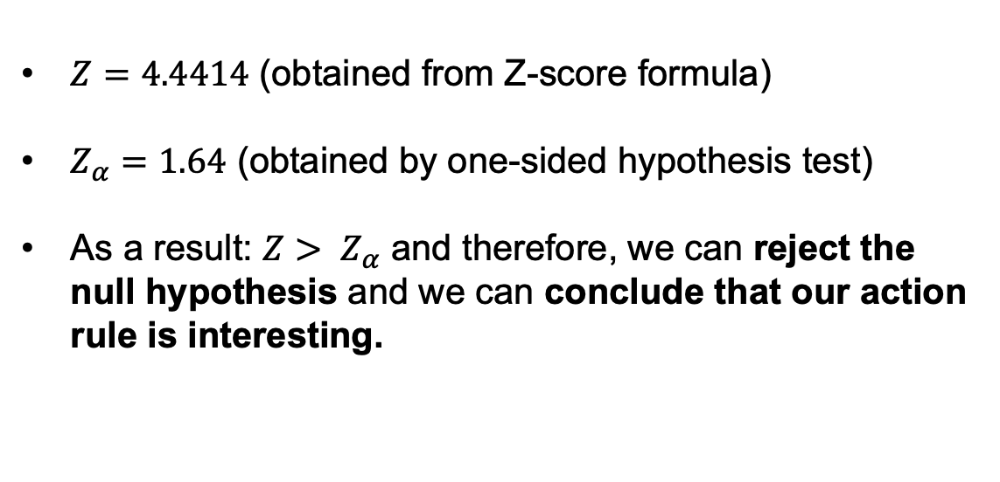
Making conclusions about Action Rules
$Z=4.4414$ (obtained from Z-score formula)
$Z_{α}=1.64$ (obtained by one-sided hypothesis test)
As a result: $Z> Z_{α}$ and therefore, we can reject the null hypothesis and we can conclude that our action rule is interesting.

