Slide 1
Action Rule Examples

Slide 2
Action Rule Examples:
The re-classification in e-commerce applications may imply that a client who was previously uninterested in a product could now purchase it, and therefore fall into a category of more profitable consumers.
The re-classification in the medical domain could relate to how to shift a tumor’s classification from dangerous to harmless.
Practical Examples of Action Rule:
Let us consider two databases and using these certain action rules are extracted. The Databases are
Binding to thrombin database
Insurance company benchmark database

Slide 3
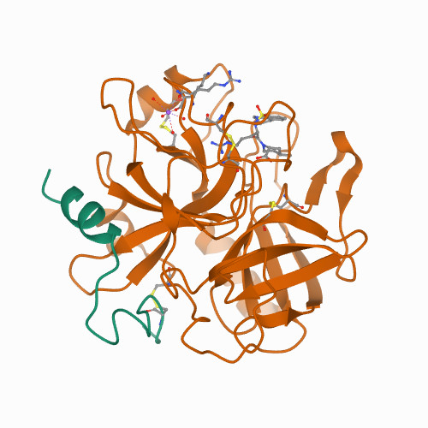
Binding to thrombin database:
The Binding to Thrombin database, which is used for drug design and was provided as part of the KDD Cup 2001 Competition, is the first database.
The database contains 1909 chemicals that were investigated for their capacity to bind to a specific location on thrombin, a critical mechanism in blood clotting.
Drugs are typically small organic molecules that achieve their desired activity by binding to a target site on a receptor.
Researchers must now figure out what distinguishes active (binding) molecules from inactive (non-binding) chemicals.
This information may then be utilized to create new molecules that not only bind but also have all of the other features that a medication requires are solubility, oral absorption, lack of side effects, appropriate duration of action, toxicity.
Structure of thrombin

Slide 4
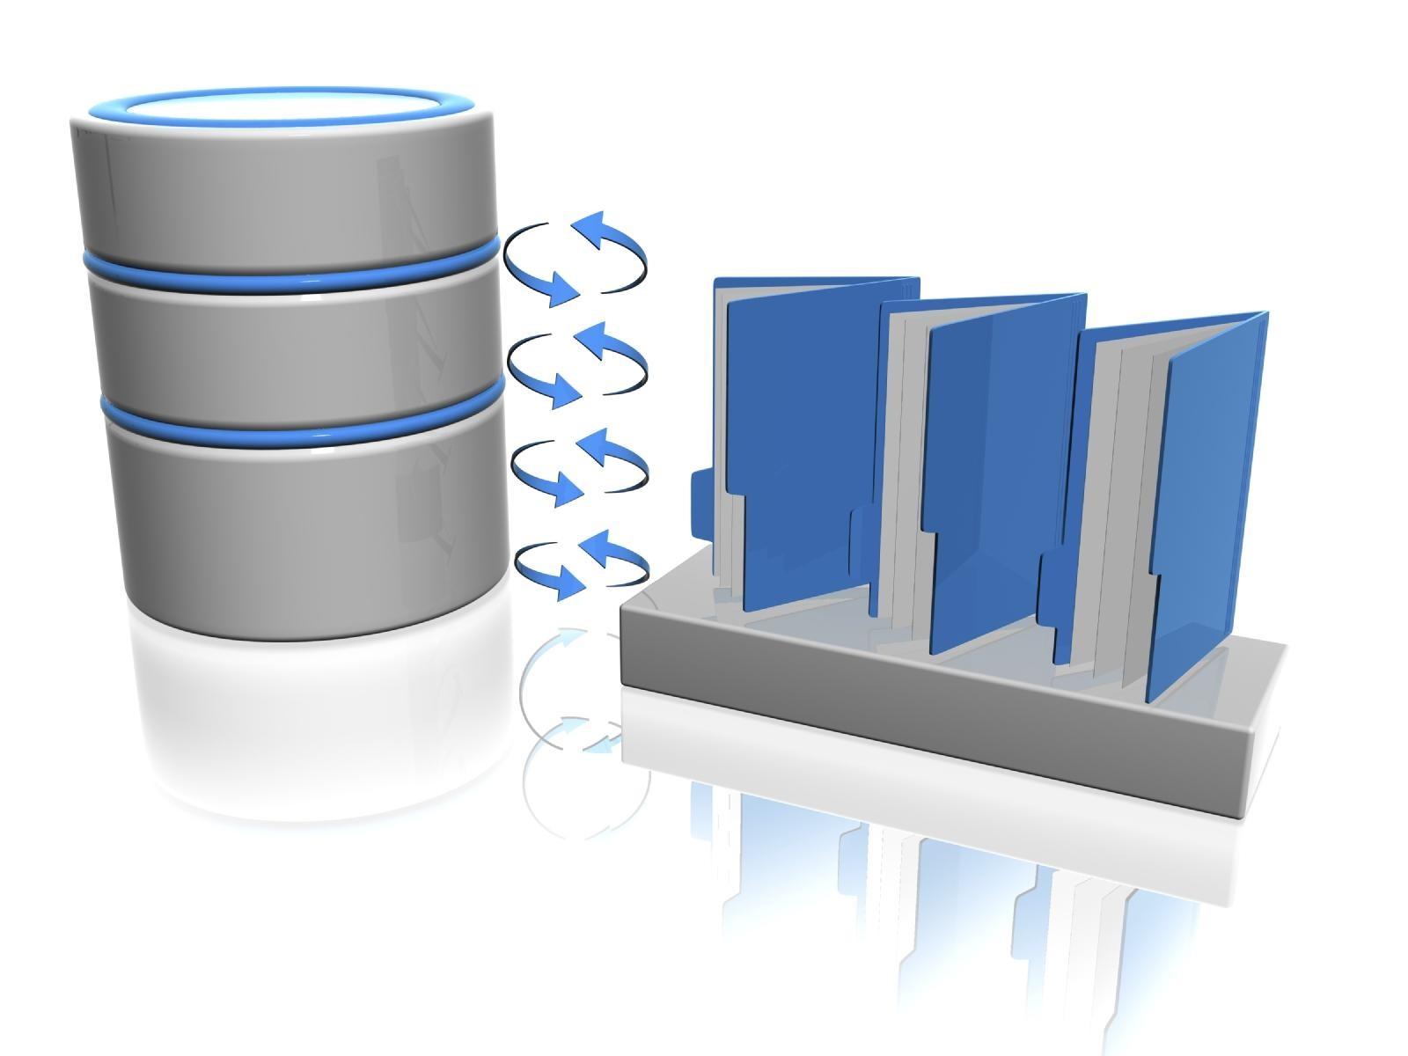
With KDD Cup 2001, the goal was to figure out which of these features was more important in this scenario and to learn to anticipate the class value: Active or Inactive. The class attribute, which has values A for active and I for inactive, is used as the re-classification attribute for the action rules in this testing.
In this method, it is recommended to the user which molecular features need to be modified to reclassify the chemical molecule from inactive to active for it to attach to thrombin.

Slide 5
The LowestCostReclassifier produced the following results:
decisionAttribute = activity valueFrom = 0 valueTo = 1
dataFile= thrombin numberOfObjects: 1908
minConfidenceL1 = 0.65 minFeasibilityL3 = 0.0001 knownCost = 0.3 maxCostL2 = 0.01
---- Goal Node: (f304, 1->0 | 0.12327) => (activity, 0->1 | 0.3) 1 (f172, 0->1 | 0.00472118) => (f304, 1->0 | 0.12327) 0.998424
---- Action Rule of Min Cost Found: ---- (f172, 0->1 | 0.00472118) => (activity, 0->1 | 0.3) 0.998424

Slide 6
Insurance Company Benchmark database:
The Insurance Company Benchmark (COIL 2000) database, which was utilized with the COIL 2000 Challenge, is the next database in the financial domain.
There are 5,822 tuples in the data. Product usage data and cultural data derived from zip area codes are among the characteristics.
Sentient Machine Research, a Dutch data-mining firm, provided the data, which is based on a real-world business issue.
During our testing, the user requested that the attribute Contribution car rules be reclassified from a value of 5 to a value of 6.
Similarly, we need to calculate the LowestCostReclassifier for the Insurance Company Benchmark database.

Slide 7
Thank You

