Slide 1
data analysis methods in RSES
Missing Value Completion
Cuts, Discretization and grouping
Linear Combination
Reducts and Decision rules

Slide 2
MISSING VALUE COMPLETION
RSES offers four approaches to the issue of missing values(MISSING, NULL or ’?’):
Remove objects with missing values
Complete with most common or mean value
Disregard during rule/reduct calculation
Treating the missing data as information
Example of RSES data set :
ATTRIBUTES 5
temperature numeric 1
headache numeric 0
cough symbolic
catarrh symbolic
disease symbolic
OBJECTS 4
38.7 7 no no angina
38.3 MISSING yes yes influenza
MISSING 3 no no cold
36.7 1 no no healthy
Notes:
Example of RSES data set :
TABLE therapy
ATTRIBUTES 5
temperature numeric 1
headache numeric 0
cough symbolic
catarrh symbolic
disease symbolic
OBJECTS 4
38.7 7 no no angina
38.3 MISSING yes yes influenza
MISSING 3 no no cold
36.7 1 no no healthy

Slide 3
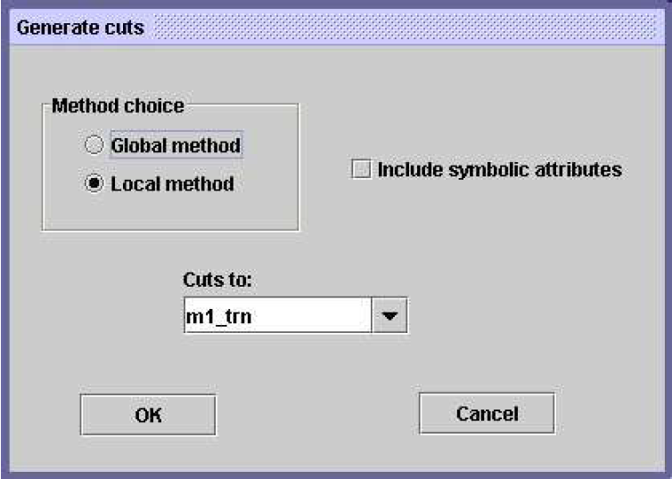
Cuts, discretization and grouping
We generate decompositions/cuts of attributes i.e., discretization of numerical attributes or grouping of nominal attributes using local or global methods.
The default extension for RSES file containing cuts is .cut
Example:
temperature numeric 1
[ 38.5 ]
cough symbolic
[ { MISSING,no } ]
Notes:
Global Method:
CUT_SET demo_global
ATTRIBUTES 4
INCLUDED_SYMBOLIC false
temperature numeric 1
[ 38.5 ]
headache numeric 0
[ 5.0 ]
cough symbolic
[ ]
catarrh symbolic
[ ]
Local Method:
CUT_SET demo_local
ATTRIBUTES 4
INCLUDED_SYMBOLIC true
temperature numeric 1
[ 37.5 ]
headache numeric 0
[ 2.0 5.0 ]
cough symbolic
[ { MISSING,no } ]
catarrh symbolic
[ ]

Slide 4
LINEAR COMBINATIONS
RSES makes it possible to add an attribute to decision table.
This new attribute is created as a weighted sum of selected existing (numerical) attributes.
The default extension for RSES file containing cuts is .dir
Example:​
DIRECTIONS (3)​
temperature*0.707+headache*0.707​
temperature*0.705+headache*0.705+disease*(-0.062)​
temperature*0.696+headache*0.696+disease*0.174

Slide 5
REDUCTS AND DECISION RULES
A reduct is a minimum subset of attributes that retains the same discernibility capacity as the whole set of attributes.
The default extension for RSES file containing reducts is .red
Example:​
REDUCTS (5)
{ temperature, headache } 1.0
{ headache, cough } 1.0
{ headache, catarrh } 1.0
{ cough } 0.25
{ catarrh } 0.25

Slide 6
REDUCTS AND DECISION RULES
Decision rules make it possible to classify objects, i.e. assign the value of decision attribute.
The default extension for RSES file containing rules is .rul
Example:
RULES 16
(temperature=38.7)&(headache=7)=>(disease=angina[1]) 1
(temperature=38.3)&(headache=MISSING)=>
(disease=influenza[1]) 1
(temperature=MISSING)&(headache=3)=>(disease=cold[1]) 1
(temperature=36.7)&(headache=1)=>(disease=healthy[1]) 1
...
(catarrh=no)=>(disease={angina[1],cold[1],healthy[1]}) 3
...
DECISION_VALUES 4
angina
influenza
cold
Healthy

