Slide 1
Perks of using FP Growth Strategy
A comparative study

Slide 2
Parameters Where Fp Growth Strategy Is Better
Database Scans
Memory Utilization
Execution Time

Slide 3
Experimental Study On Datasets
SuperMarket Dataset:
4627 Transactions
217 Attributes
Mushroom Dataset:
8124 Transactions
22 Attributes
*UCI repository of ML Databases

Slide 4
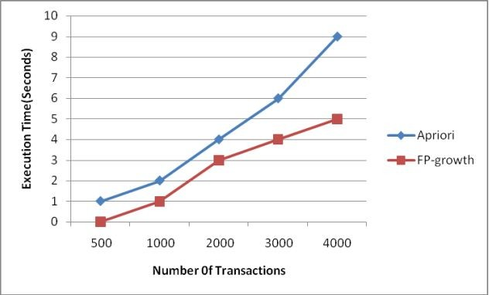
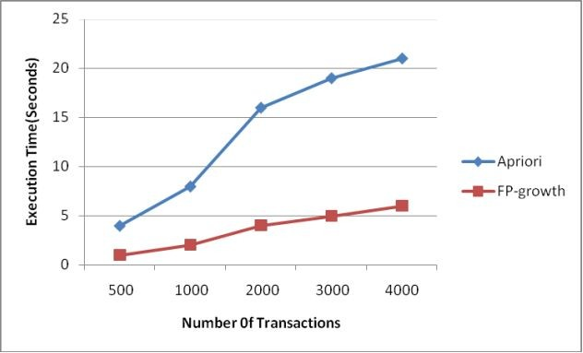
Execution Time Vs Transactions
Mushroom Data (Support = 0.1)
SuperMarket Data (Support = 0.1)

Slide 5
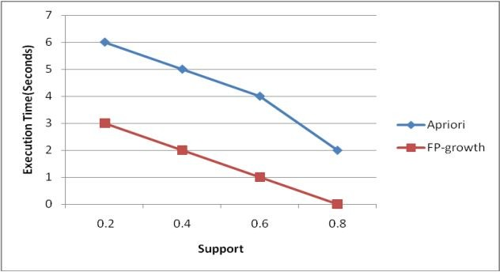
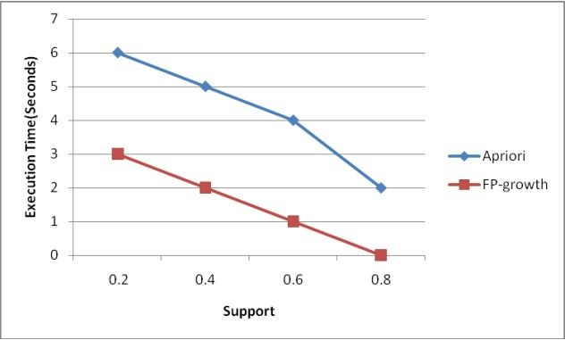
Execution Time Vs Support
Mushroom Data (2000 Transactions)
SuperMarket Data (2000 Transactions)

