Slide 1
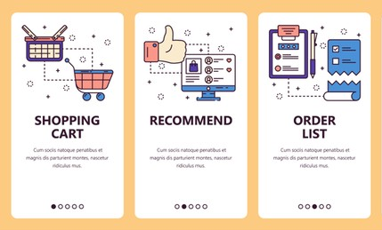
FP TREE EXAMPLE

Slide 2
EXAMPLE
Step 1: Compute Frequency of each item
Transaction ID | Items
T1 | {E, K, M, N, O, Y}
T2 | {D, E, K, N, O, Y}
T3 | {A, E, K, M}
T4 | {C, K, M, U, Y}
T5 | {C, E, I, K, O}
Item | Frequency
A | 1
C | 2
D | 1
E | 4
I | 1
K | 5
M | 3
N | 2
O | 3
U | 1
Y | 3
Minimum Support Count: 3
Eliminate items with support count less than minimum support.
Order of Priority:
K
E
M
O
Y

Slide 3
Step 2: Reorder the items based on order of priority
Transaction ID | Items
T1 | {E, K, M, N, O, Y}
T2 | {D, E, K, N, O, Y}
T3 | {A, E, K, M}
T4 | {C, K, M, U, Y}
T5 | {C, E, I, K, O}
Transaction ID
Items
T1
{K, E, M, O, Y}
T2
{K, E, O, Y}
T3
{K, E, M}
T4
{K, M, Y}
T5
{K, E, O}
Order of Priority: K E M O Y

Slide 4
Step 3: Construction of FP Tree
T2: {K, E, O, Y}
T3:{K, E, M}
T1: {K, E, M, O, Y}
null
null
null
K:1
K:1
K:2
K:2
K:3
E:1
E:1
E:2
E:3
E:2
M:1
M:1
O:1
M:2
M:1
O:1
O:1
O:1
Y:1
O:1
Y:1
Y:1
Y:1
Y:1

Slide 5
T4:{K, M, Y}
T5:{K, E, O}
null
null
K:3
K:5
K:4
K:4
E:3
M:1
E:3
M:1
E:4
M:2
O:1
Y:1
M:2
O:1
O:2
Y:1
O:1
Y:1
O:1
Y:1
Y:1
Y:1

Slide 6
Step 4: Find Conditional pattern base & Conditional Frequent Pattern Tree
Conditional Pattern Base: All the possible paths to reach a particular item in the FP tree
Conditional Frequent Pattern Tree: Set of elements that is common in all the paths in the Conditional Pattern Base of that item
Items
Conditional Pattern Base
Conditional Frequent
Pattern Tree
Y
{{K, E, M, O:1}, {K, E, O:1}, {K, M:1}}
{K:3}
Step 5: Generate Frequent Patterns
O
{{K, E, M:1}, {K, E:2}
{K, E:3}
Frequent patterns are generated by pairing the items of the Conditional Frequent Pattern Tree set to the corresponding item
M
{{K, E:2}, {K:1}}
{K:3}
E
{K:4}
{K:4}
K
Frequent Patterns: {{K, Y:3}, {K, O: 3}, {E, K, O:3}, {K, M:3}, {E, K:3}}

Slide 7
THANK YOU

