Slide 1
APRIORI ALGORITHM

Slide 2
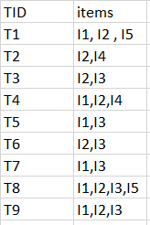
Example of Apriori Algorithm
minimum support count is 2
minimum confidence is 60%

Slide 3
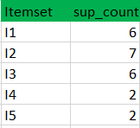
Step-1:
(I) Create a table containing support count of each item present in dataset – Called C1(candidate set)
(II) compare candidate set item’s support count with minimum support count(here min_support=2 if support_count of candidate set items is less than min_support then remove those items). This gives us itemset L1.

Slide 4
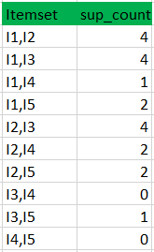
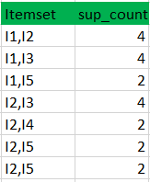
Step-2:
Generate candidate set C2 and compare candidate (C2) support count with minimum support count
Table 1 Table 2

Slide 5
Step-3:
Generate candidate set C3
Compare candidate (C3) support count with minimum support count

Slide 6
Step-4:
Generate candidate set C4 is that, they should have elements in common. So here, first 2 elements (items) should match.
Check all subsets of these itemsets are frequent or not (Here itemset formed by joining is {I1, I2, I3, I5} so its subset contains {I1, I3, I5}, which is not frequent). So no itemset in C4
We stop here because no frequent itemsets are found further

Slide 7
Advantages
This is the most simple and easy-to-understand algorithm among association rule learning algorithms.
It doesn't require labeled data as it is fully unsupervised; as a result, you can use it in many different situations because unlabeled data is often more accessible
Disadvantages
Requires many database scans.
Very slow.
The time needed to hold a large number of candidate-sets with many frequent itemsets.
If the dataset is small, the algorithm can find many false associations that happened simply by chance.

Slide 8
LIMITATIONS
Apriori Algorithm can be very slow when the size of database is huge.
For example If there are 10⁵ frequent 1-item sets then it will generate 10⁷ 2-item sets
Apriori algorithm will fail when the size of the database is very large as DB will not fit in memory. So each prune requires large number of disk reads.

Slide 9
Methods to Improve Apriori Efficiency
Partitioning : Any item set that is frequent in database must be frequent in one of its partitions.
Sampling: With the help of random sampling
Transaction Reduction : A transaction that doesn’t contain any frequent itemsets is useless for the scan.
By using new database mapping way to avoid scanning the DB repeatedly.

Slide 10
THANK YOU

