Slide 1
Sliding Window & Data Link Protocols

Slide 2
3.4: Sliding Window Protocols

Slide 3
Media Access Control Address
Address Location
Locally administered
Universally administered/burned in
U/L bit
U/L bit Determines if Unicast or Multicast

Slide 4
OSI Model

Slide 5
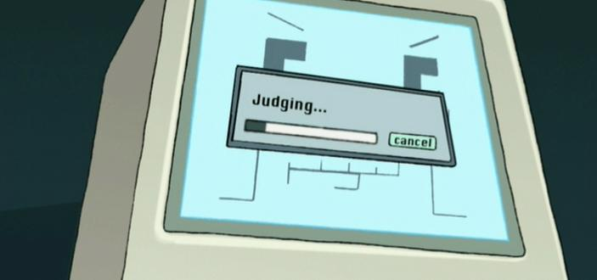
Local Link Control
Originally
Multiplexing protocols on MAC
Flow Control and Error Control
Currently
Only handles multiplexing
Flow Control and Error Control handled by Transport Layer

Slide 6
Question Time:
1. What do the first three octets in a MAC address represent as a universally administered address?
Hint: Known as OUI.

Slide 7
Frames
Data packet in layer 2 of OSI
Tells receiver beginning and end of data stream
Frame Sync.
Examples of Frames:
PPP, V.42 Modern Frames, Ethernet Frame

Slide 8
Question Time.
What does Frame Sync do?

Slide 9
General Intro into Sliding Window Protocol Go Back N
https://www.youtube.com/watch?v=yT8SkFyRRrI

Slide 10
Flow Control

Slide 11
Basics of Flow Control
Definition
Flow Control is the process of regulating the rate at which data is transmitted between two nodes.

Slide 12
Basics of Flow Control
Purpose of Flow Control:
Receiver Control of Transmission Speed
Preventing Congestion
Three Flow Control Protocols:
Stop-and-Wait/One Bit
Go-Back-N(SWP)
Selective Repeat(SWP)
Notes:
Protocols can be found in the Data Link Layer and the Transport Layer in the OSI Model

Slide 13
Stop & Wait/One Bit
Very Simple ARQ(Automatic Repeat Request) Method
System of Requests and Acknowledgements
Allows for Proper Error Handling
Frames Sent One at A Time to Receiver
Once Processed:
ACK (Acknowledgement) from Receiver to Sender
The Sending Node Sends Another Frame
Sending Node
Receiver Node
Notes:
Is inefficient because:
Only once frame can be sent at a time because:
The Sender has to wait for an ACK

Slide 14
Stop & Wait/One Bit
Time Is A Critical Component!
A time-out occurs when:
The Receiver does not receive frame or
The Sender does not receive the ACK within a designated period of time
The Three Scenarios
Frame time-out
Frame Reaches Receiver & ACK is sent back
ACK time-out

Slide 15
Questions
What are the two purposes of flow control?
What is the step by step process of the Stop & Wait Protocol?
Receiver Control of Transmission Speed
Preventing Congestion
Frames Sent One at A Time to Receiver
Once Processed:
ACK (Acknowledgement) from Receiver to Sender
The Sending Node Sends Another Frame

Slide 16
Go-Back-N Sliding Window Protocol
Long Transit Time
High Bandwidth
Short Frame Length
Notes:
Before, we have assumed that the transmission time for both the receiving and acknowledgement was negligible. With a long trip to make, the efficiency of sending one packet at a time goes down; especially when there is bandwidth to spare. Wouldn’t it be better if there was the rule limiting the amount of frames being sent to a mere 1 could increase? This can be accomplished by allowing the sender to transmit up to X frames before blocking. With this method, if X (which is the max frames) is large enough and it has acknowledgements coming in before the sender’s window fills up, frames can be continuously sent.
Visualize a pizza delivery company. They have only so many drivers to deliver the pizzas. They send them out, let’s pretend they can only send one at a time; and while we are imagining, also let it be that all deliveries are in a single complex to make the trip the same distance for each driver. Now you have a stream of drivers going to a location to deliver something and coming back to make another delivery. If they have enough drivers, those who have made the delivery will be arriving back at the store in time to pick up another pizza and return on the sender’s path.
Think circulation of cars constantly returning to the sender on a two lane road.
Can anyone name another example of something like this? A process with a constant flow.

Slide 17
Go-Back-N Sliding Window Protocol
Bandwidth-Delay Product (P)
Bandwidth * One-way Transit Time = P
P / Number of Bits in a Frame = BD
2BD + 1 = X
Ex: Bandwidth = 50 kbps
One-way Transit Time = 250 msec
Number of Bits in a Frame = 1000 each
X = 26
Notes:
Bandwidth in bits/sec
Now BD is the Bandwidth-Delay Product expressed as a number of frames.
2BD is because it is a round trip and traverses the path twice. The +1 is because an acknowledgement frame will not be sent until a complete frame is received.
50 * 250 = 12,500 with 1000 bits per frame that is 12.5 frames
Who can tell me what X will be?
So after the sender has sent 26 frames, it will be receiving the acknowledgement from the first. It will continue in this fashion with 25 or 26 unacknowledged frames always being outstanding. Another way to put it is the sender’s maximum window size is 26.

Slide 18
Go-Back-N Sliding Window Protocol
Pipelining
Go-Back-N
Discard all frames after missing one
Selective Repeat
Only sends latest unacknowledged
Notes:
Pipelining is the technique of keeping multiple frames in flight. This method can cause serious issues if attempting it over an unreliable communication channel. What happens if one file in the mix is damaged or lost? The receiver will have multiple files that are successful but how does it handle the fact that one is missing?
The first method is the Go-Back-N method. Throw away all frames and don’t send any acknowledgements for them. When the timer runs out for the ones missing, they will ALL get resent. This approach can waste a lot of bandwidth if the error rate is high.
The Selective Repeat method involves discarding only the corrupt file and buffering the successful ones. When the timer runs out, the sender only sends the latest unacknowledged frame. Then all files are ready to be presenter to the receiver in sequence still. This method requires large amounts of data link memory if the window is large.
Trade-off between efficient use of bandwidth or data link buffer space. It will depend on which you have more to spare.

Slide 19
Go-Back-N Sliding Window Protocol
Cumulative Acknowledgement
Acknowledgement for frame N acknowledges all below it (N-1, N-2, etc.)
Notes:
Dwarves represent one containing more. Ex. “The Seven Dwarves” are are a unified group when you think about it. Sure you know their names but they are always together. You could see Doc in the mine and assume they are all in there. In other words, seeing one is enough to understand that they are all following.

Slide 20
Selective Repeat Sliding Window
Accepted Out of Order
a.) Initial situation with a window size of 7
b.) After 7 frames sent and received but not acknowledged
Notes:
As long as it is in the window, it is accepted regardless of sequence but stays in data link layer. It is only allowed into the network layer when the prior frames in the sequence are filled.
Key: Accepted out of order
Problem: the receiver advanced it’s window too early; the following batch of frames could be duplicates (if not all the acknowledgements were received) or new frames (if all went through) but the receiver has no way of telling them apart.
To fix this, the maximum window size should be at most half of the range of sequence numbers.
Both the sender and receiver maintain a window of outstanding and acceptable sequence number.

Slide 21
3.5: Example
Data Link Protocols

Slide 22
Point-to-Point Protocol
Point-to-Point Protocol is used to send packets over links
Allows for connection, authentication, and compression of data

Slide 23
Question!
What does PPP stand for?
Point-to-Point Protocol

Slide 24
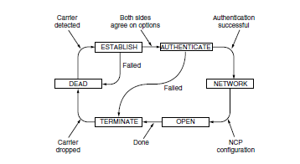
Point-to-Point Protocol (Continued)
PPP link must be established and configured before frames can be sent.

Slide 25
Question!
Which of the following happens when the Authentication step of configuring a PPP link fails?
Network
Establish
Terminate
Dead

Slide 26
Packet over SONET
Recurring fixed byte payloads no matter if there is user data to send or not
One unusual feature of PPP is that the payload is scrambled before being inserted into the SONET payload

Slide 27
Packet over SONET (Continued)
PPP runs on IP routers
The framing mechanism distinguishes between occasional packets from the continuous bitstream

Slide 28
Question!
PPP runs on IP routers.
True or False?

Slide 29
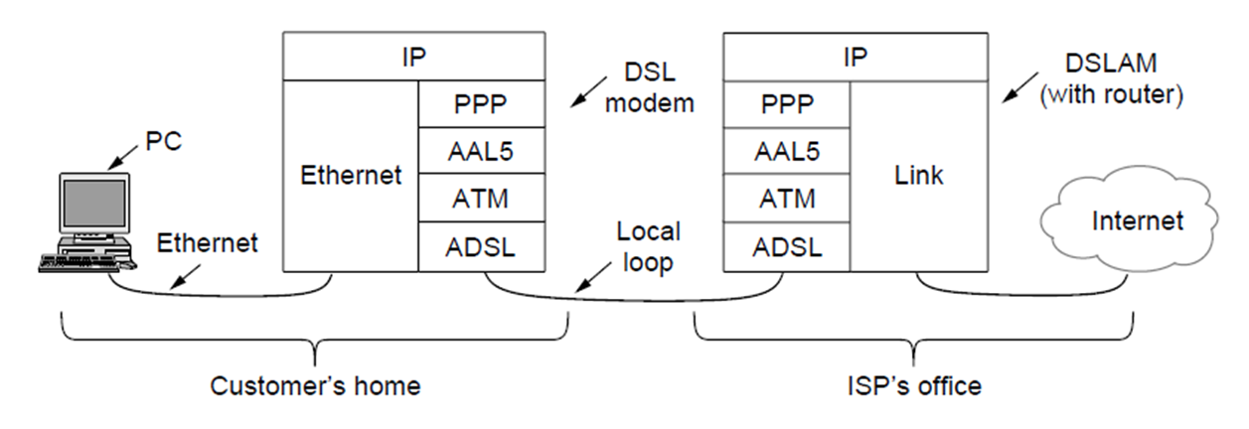
Asymmetric Digital Subscriber Loop
(ADSL)
ADSL modem client-side sends data to DSLAM (DSL Access Multiplexer) over the analog “local loop”
Notes:
“local loop” = telephone wire aka Cat. 3 UTP between home and ISP
ADSL (OSI Layer 1 / Physical) uses Orthogonal Frequency Division as in 2.5.3

Slide 30
Asynchronous Transfer Mode (ATM)
Data transmitted in fixed-length “cells”
Cells contain 48 B of data + 5 B header (total 53 Bytes per cell)
Header contains a virtual circuit identifier (among other fields) to specify route/destination
Notes:
ATM is ADSL’s link layer protocol, incorporating AAL5 (and thus PPP) in its operation.
small size to facilitate link subdivision (between voice and data, for example)
“By using small cells, ATM can flexibly divide the bandwidth of a physical layer link among different users in fine slices. This ability is useful when, for example, sending both voice and data over one link without having long data packets that would cause large variations in the delay of the voice samples.” p. 249

Slide 31
ATM Adaptation Layer 5 (AAL5)
Specific adaptation layer used for packet data (as opposed to voice et cetera)
Padding to a multiple of 48 Bytes to fit neatly in ATM cells
Addressing handled by each ATM cell’s virtual circuit identifier

Slide 32
PPP over AAL5 (PPPoA)
PPP’s protocol field tells DSLAM the payload’s protocol
Protocol & Payload fields only
no framing - using ATM/AAL5’s cells & framing
no CRC - we’re using AAL5’s CRC
Notes:
Our ADSL Matryoshka doll is this: Internet Protocol (Network / OSI Layer 3) data is put into the PPP payload, and protocol is set to indicate IP data. A CRC is calculated and along with the data is inserted into the AAL5 frame (as shown). That’s padded out to a multiple of 48 Bytes, and then divided up. Each 48 B chunk has applied a 5 B header containing such things as the virtual circuit identifier. Cells are then sent out over ADSL.

Slide 33
ADSL Framing
IP packet data goes into the PPP payload of the shown AAL5 frame
CRC calculated and AAL5 frame padded to multiple of 48 B, then divided.
5 Byte ATM header containing the virtual circuit identifier added to each piece
ATM cells sent out over ADSL.

Slide 34
Questions!
What does ATM stand for?
Asynchronous Transfer Mode
2. For IP data transmission on an ADSL line, in what order are protocols nested?
IP (in PPP) in AAL5 in ATM over ADSL

Slide 35
Summary
The overall purpose of the all the sliding protocols is to convert any raw bit stream offered by the physical layer into a stream of frames so they can be used in the network layer

