Slide 1
Deadlocks

Slide 2
Table of Content
Resources
Introduction to Deadlocks
The Ostrich Algorithm
Deadlock Detection and Recovery
Deadlock Avoidance
Deadlock Prevention
Other Issues
Research
Summary

Slide 3
Deadlocks –
When two or more processes are executed the same command and cannot be completed until the other process is complete.

Slide 4
Resources
Preemptable –a process that can be taken away from the process owning it with no ill effects.
Nonpreemptable – a process that cannot be taken away from the process owning it without causing the computation to fail.

Slide 5
Resource Acquisition
Semaphores – controls access to a common resource.
Mutexes – allows threads to share the same resource.

Slide 6
Introduction to Deadlocks
Resource Deadlock – Happens when no process can run, none can be released and none can be awakened.

Slide 7
Introduction to Deadlocks
Mutual exclusion condition
Hold and wait condition
No preemption condition
Circular wait condition

Slide 8
Deadlock Mapping

Slide 9
Deadlock Mapping

Slide 10
The Ostrich Algorithm
Overview Of Deadlocks and the Ostrich Algorithm
Video 1

Slide 11
OVERVIEW - Deadlock Detection and Recovery - Deadlock detection with one resource of each type - Deadlock detection with multiple resources of each type -Recovery from Deadlocks - Through Preemption - Through Rollback - Through Killing Processes - Deadlock Avoidance

Slide 12
DETECTION - Under deadlock detection, deadlocks are allowed to occur - Following a deadlock, the state of the system is examined to detect that a deadlock has occurred and is subsequently corrected

Slide 13
DETECTION - An algorithm is employed that tracks resource allocation and process states. - It rolls back and restarts one or more of the processes in order to removed the detected deadlock.

Slide 14
DETECTION - Detecting a deadlock that has already occurred is easily possible - Since the resources that each process has locked and/or currently requested are known to the resource scheduler of the operating system

Slide 15
Deadlock detection with one resource of each type Simple example: Computer that has only ONE of the following: - Scanner - CD/DVD Drive - Printer - Tape Drive etc.

Slide 16
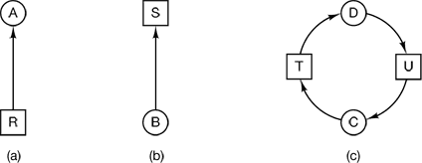
Deadlock detection with one resource of each type a. Holding a resource b. Requesting a resource c. Deadlock

Slide 17
DEADLOCKS
COMBINED APPROACH TO DEADLOCK HANDLING:
Type of resource may dictate best deadlock handling. Look at ease of implementation, and effect on performance.
In other words, there is no one best technique.
Cases include:
Preemption for memory,
Preallocation for swap space,
Avoidance for devices ( can extract Needs from process. )

Slide 18
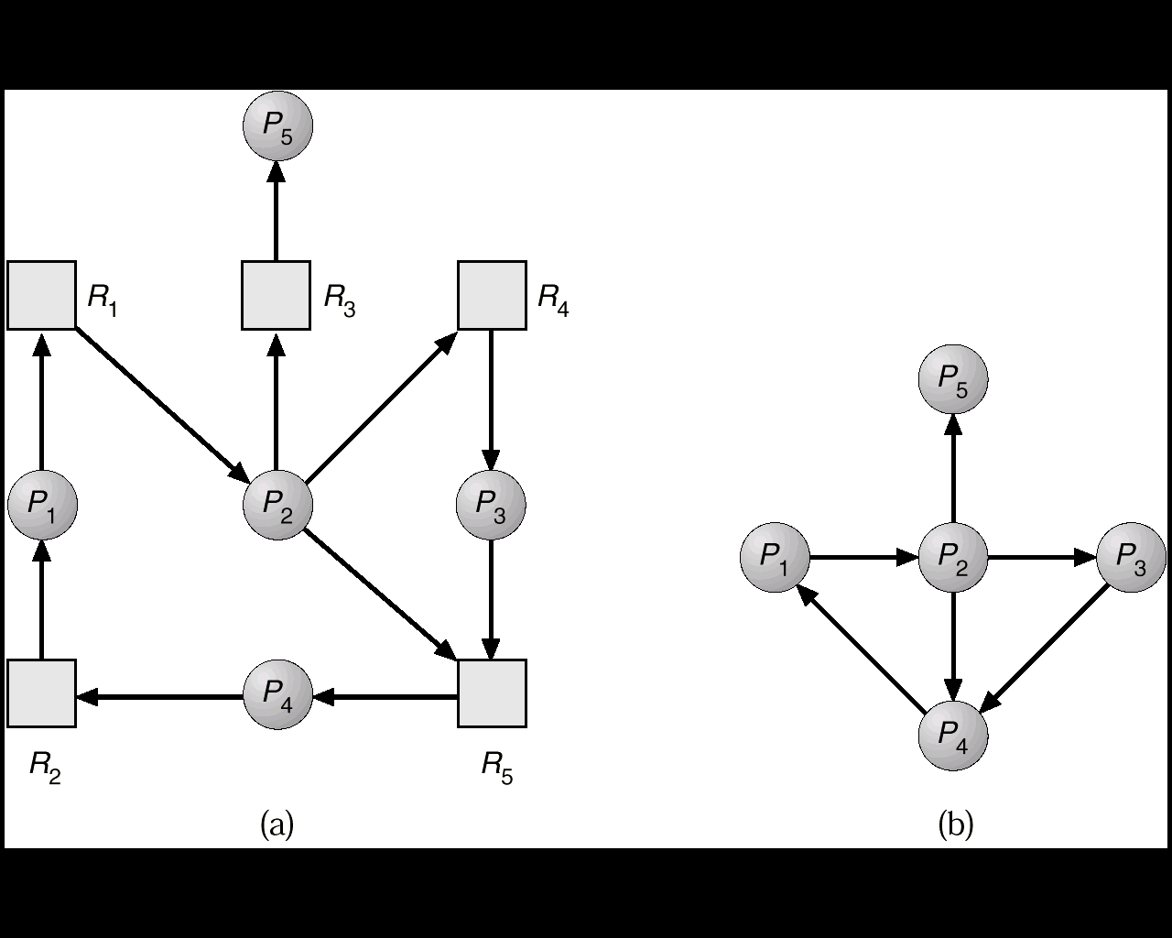
DEADLOCKS
Deadlock Detection
Need an algorithm that determines if deadlock occurred.
Also need a means of recovering from that deadlock.
SINGLE INSTANCE OF A RESOURCE TYPE
Wait-for graph == remove the resources from the usual graph and collapse edges.
An edge from p(j) to p(i) implies that p(j) is waiting for p(i) to release.
18

Slide 19
DEADLOCKS
Deadlock Recovery
So, the deadlock has occurred. Now, how do we get the resources back and gain forward progress?
PROCESS TERMINATION:
Could delete all the processes in the deadlock -- this is expensive.
Delete one at a time until deadlock is broken ( time consuming ).
Select who to terminate based on priority, time executed, time to completion, needs for completion, or depth of rollback
In general, it's easier to preempt the resource, than to terminate the process.
RESOURCE PREEMPTION:
Select a victim - which process and which resource to preempt.
Rollback to previously defined "safe" state.
Prevent one process from always being the one preempted ( starvation ).

Slide 20
DEADLOCKS
Deadlock Detection
SEVERAL INSTANCES OF A RESOURCE TYPE
Complexity is of order m * n * n.
We need to keep track of:
available - records how many resources of each type are available.
allocation - number of resources of type m allocated to process n.
request - number of resources of type m requested by process n.
Let work and finish be vectors of length m and n respectively.
20

Slide 21
DEADLOCKS
Deadlock
Prevention
Do not allow one of the four conditions to occur.
No preemption:
a) Release any resource already being held if the process can't get an additional resource.
b) Allow preemption - if a needed resource is held by another process, which is also waiting on some resource, steal it. Otherwise wait.
Circular wait:
Number resources and only request in ascending order.
EACH of these prevention techniques may cause a decrease in utilization and/or resources. For this reason, prevention isn't necessarily the best technique.
Prevention is generally the easiest to implement
21

Slide 22
Recovery through Rollback
If the system designers and machine operators know that deadlocks are likely,
They can arrange to have processes checkpointed periodically
Checkpointing a process means that a state is written to a file so that it can be restarted later
The checkpoint contains no only the memory image, but also the resource state, in other words, which resources are currently assigned to the process.

Slide 23
Recovery through Preemption
In some cases it may be possible to temporarily take a resource away from its current owner and give it to another process
The ability to take a resource away from a process, have another process use it, and then give it back without the process noticing it is highly dependent on the nature of the resource
Recovering this way is frequently difficult or impossible

Slide 24
Recovery through Killing Process
Crudest, but simplest way to break a deadlock is to kill one or more processes
One possibility is to kill a process in the cycle
Where possible, it is best to kill a process that can be rerun from the beginning with no ill effects

Slide 25
DEADLOCKS
Deadlock
Avoidance
NOTE: All deadlocks are unsafe, but all unsafes are NOT deadlocks.
SAFE
UNSAFE
DEADLOCK
Only with luck will processes avoid deadlock.
O.S. can avoid
deadlock.
25

Slide 26
DEADLOCKS
Deadlock
Avoidance
If we have prior knowledge of how resources will be requested, it's possible to determine if we are entering an "unsafe" state.
Possible states are:
Deadlock No forward progress can be made.
Unsafe state A state that may allow deadlock.
Safe state A state is safe if a sequence of processes exist such that there are enough resources for the first to finish, and as each finishes and releases its resources there are enough for the next to finish.
The rule is simple: If a request allocation would cause an unsafe state, do not honor that request.
NOTE: All deadlocks are unsafe, but all unsafes are NOT deadlocks.

Slide 27
Banker’s Algorithm:
Tentatively grant each resource request
Analyze resulting system state to see if it is safe
If safe, grant the request
if unsafe refuse the request (undo the tentative grant)
block the requesting process until it is safe to grant it.

Slide 28
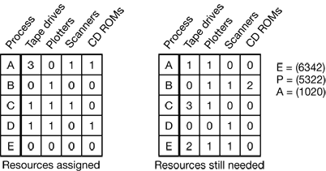
BANKER’S ALGORITHM
We see two matrices.
The one on the left shows how many of each resource are currently assigned to each of the five processes.
The matrix on the right shows how many resources each process still needs in order to complete.

Slide 29
BANKER’S ALGORITHM
As in the single resource case, processes must state their total resource needs before executing
So that the system can compute the right-hand matrix at each instant

Slide 30
Deadlock Prevention
How can we prevent deadlocks?
Condition | Approach
Mutual exclusion | Spool Everything
Hold and Wait | Request all resources initially
No Preemption | Take resources away
Circular Wait | Order resources numerically

Slide 31
Deadlock Prevention
Attacking the Mutual Exclusion Condition
Attacking the Hold and Wait Condition
Attacking the No Preemption Condition
Attacking the Circular Wait Condition

Slide 32
Deadlock Prevention
Attacking Mutual Exclusion:
Removing the mutual exclusion condition means that no resource will have exclusive access to a single process.
The mutual-exclusion condition must hold for resources that can be spooled (i.e., a printer)

Slide 33
Deadlock Prevention
Problems with Attacking Mutual Condition:
We cannot prevent deadlocks by denying the mutual-exclusion condition, because some resources are intrinsically non-sharable which means they cannot be spooled.

Slide 34
Deadlock Prevention
Attacking the Hold and Wait Condition:
Requires all processes to request all their resources before starting execution
Requires a process requesting a resource to first temporarily release all the resources it currently holds

Slide 35
Deadlock Prevention
Problems with Attacking the Hold and Wait Condition:
Many processes do not know how many resources they will need until they have started running
Resources will not be used optimally
A process that needs several popular resources may have to wait indefinitely

Slide 36
Deadlock Prevention
Attacking the No Preemption Condition:
When process that is holding some resources and requests another resource, then all resources currently being held are preempted.
The preempted resources are added to the list of resources for which the process is waiting
The process will restart only when it can regain its old resources, as well as the new ones that it was requesting

Slide 37
Deadlock Prevention
Problems with Attacking the No Preemption Condition:
Many processes will not allow preemption because preemption will cause the process to fail

Slide 38
Deadlock Prevention
Attacking the Circular Wait Condition:
Impose a total ordering of all resource types and require that each process requests resources in the same order

Slide 39
Deadlock Prevention
Problems with Attacking the Circular Wait Condition
It is impossible to find an ordering that satisfies everyone

Slide 40
Other Issues
Some other issues with deadlocks?
Two-Phase Locking
Communication Deadlocks
Livelock
Starvation

Slide 41
Other Issues
Two Phase Locking:
Occurs in many database systems
Operation that occurs frequently and requests locks on several records and then updates all the locked records

Slide 42
Other Issues
Two Phase Locking:
First Phase – the process tries to lock all the records it needs one at a time
Second Phase – performs updates and releases the locks

Slide 43
Livelock
Polling(busy waiting)is used to enter a critical region or access a resource.
Busy waiting can lead to live lock.
Overloading a table slot can lead to livelock.
Most operating systems ignore the problem.
Cannot be solved because of limited resources.

Slide 44
Starvation
Who gets the priority ?
smallest job getting the resources first.
First come- first served.

Slide 45
Research on deadlocks
Deadlocks was a heavily researched topic.
Papers still being published about deadlocks:
Runtime detection of deadlock caused of incorrect use of locks and semaphores (Agarwal and stoller,2006; and bensalem et al.,2006)
Preveting deadlocks among java threads (Permandia et al., 2007 and Williams etal., 2005)
Dealing with deadlocks in network(Jayasimha, 2003 ; Karol et al., 2003; and schafer et al. 2005)
Some research is also being done on distributed deadlock detection.

Slide 46
Summary of Livelock
Potential problem in every operating system.
Caused when a resource is being held up.
Resource dead lock can be avoided by keeping track of safe and unsafe states.
Communication dead lock can be solved by setting suitable timeouts.
Livelock can stop forward progress.
Starvation can be avoided by using first come first serve.

Slide 47
JAVA EXAMPLE - DEADLOCK
This is a demonstration of how NOT to write multi-threaded programs.
- It is a program that purposely causes deadlock between two threads that
are both trying to acquire locks for the same two resources.
- To avoid this sort of deadlock when locking multiple resources, all threads
should always acquire their locks in the same order.
// COMMENTS IN RED //

Slide 48
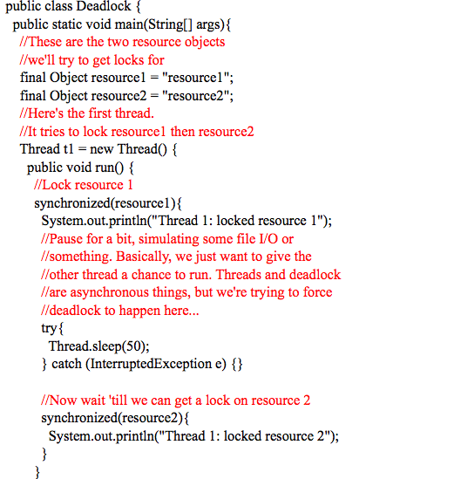
JAVA EXAMPLE – DEADLOCK (1)

Slide 49
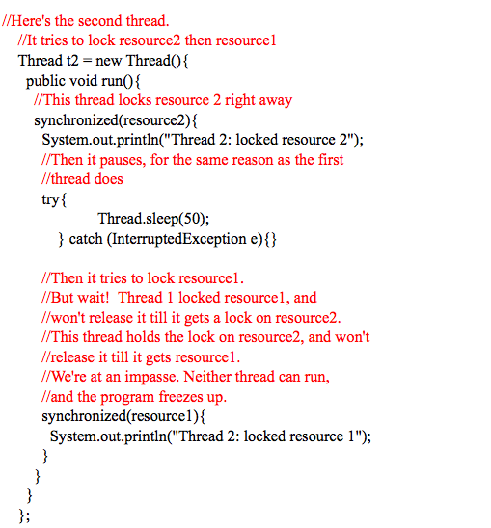
JAVA EXAMPLE – DEADLOCK (2)

Slide 50
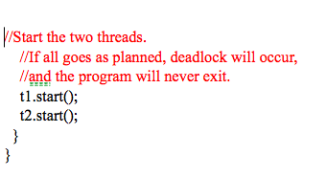
JAVA EXAMPLE – DEADLOCK (3)

Slide 51
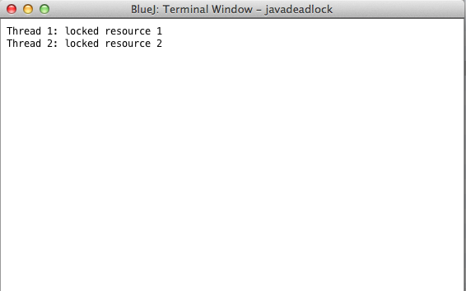
JAVA EXAMPLE – DEADLOCK (4)
OUTPUT

Slide 52
Citations
Picture 1 & picture 2 - "Deadlock Detection in Java | Mete Atamel." Mete Atamel. N.p., n.d. Web. 30 Mar. 2014.
Video 1 - "Deadlock Basics + Modelling + Ostrich Algorithm." YouTube. YouTube, 14 Apr. 2012. Web. 30 Mar. 2014.
Textbook - Tanenbaum, Andrew S. Modern Operating Systems. N.p.: n.p., n.d. Print.

Slide 53
QUIZ QUESTIONS WHAT IS AN EXAMPLE OF A RESOURCE? A. SCANNER B. DISC DRIVE C. PRINTER D. ALL OF THE ABOVE

Slide 54
Questions
What approach does the attacking mutual exclusion condition take?
Request all resources initially
Take resources away
Spool Everything
Order resources numerically

Slide 55
Questions
What approach does the attacking mutual exclusion condition take?
Spool Everything

Slide 56
Questions
Which of the following is an issue of deadlocks?
Dehydration
Starvation
Three-Phase Locking
Dreadlocks

Slide 57
Questions
Which of the following is an issue of deadlocks?
Starvation

Slide 58
Questions
Attacking the Hold and Wait condition…
Requires all processes to request all their resources before starting execution
Imposes a total ordering of all resource types
Spools everything
Does Nothing

Slide 59
Questions
Attacking the Hold and Wait condition…
Requires all processes to request all their resources before starting execution

Slide 60
QUIZ QUESTIONS WHAT IS AN EXAMPLE OF A RESOURCE? A. SCANNER B. DISC DRIVE C. PRINTER D. ALL OF THE ABOVE

Slide 61
QUIZ QUESTIONS WHAT IS AN EXAMPLE OF A RESOURCE? D. ALL OF THE ABOVE

Slide 62
QUIZ QUESTIONS ALL DEADLOCKS ARE UNSAFE A. TRUE B. FALSE

Slide 63
QUIZ QUESTIONS ALL DEADLOCKS ARE UNSAFE A. TRUE

Slide 64
QUIZ QUESTIONS WHICH OF THE FOLLOWING ALGORITHMS IS NOT RELATED TO DEADLOCKS? A. BANKER’S ALGORITHM B. OSTRICH ALGORITHM C. SANDWICH ALGORITHM

Slide 65
QUIZ QUESTIONS WHICH OF THE FOLLOWING ALGORITHMS IS NOT RELATED TO DEADLOCKS? C. SANDWICH ALGORITHM

Slide 66
Quiz Questions
True or False: Nonpreemptable is best case scenario when it comes to deadlocks.

Slide 67
Quiz Questions
False : Nonpreemptable means the resources cannot be freed from their owners without harm.

