Slide 1
Group 8
Virtualization of the Cloud
Units 7.11 - 7.13

Slide 2
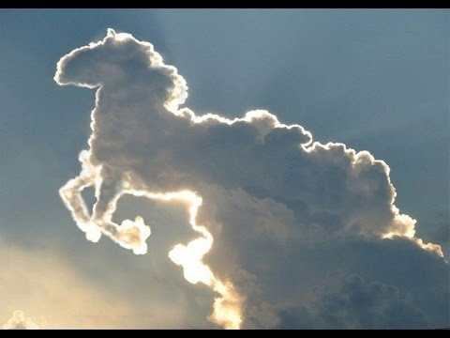
The Cloud:
The cloud is a pony...

Slide 3
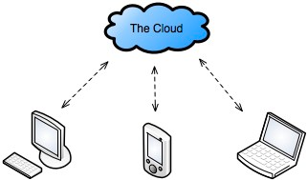
What is a cloud? Don’t think about it, the CLOUD will think for you!
Companies can outsource computing and data-storage needs to large, well-managed data-centers run by specialists.
This means, they pay someone to manage their IT department for them, and then access it through a network.

Slide 4
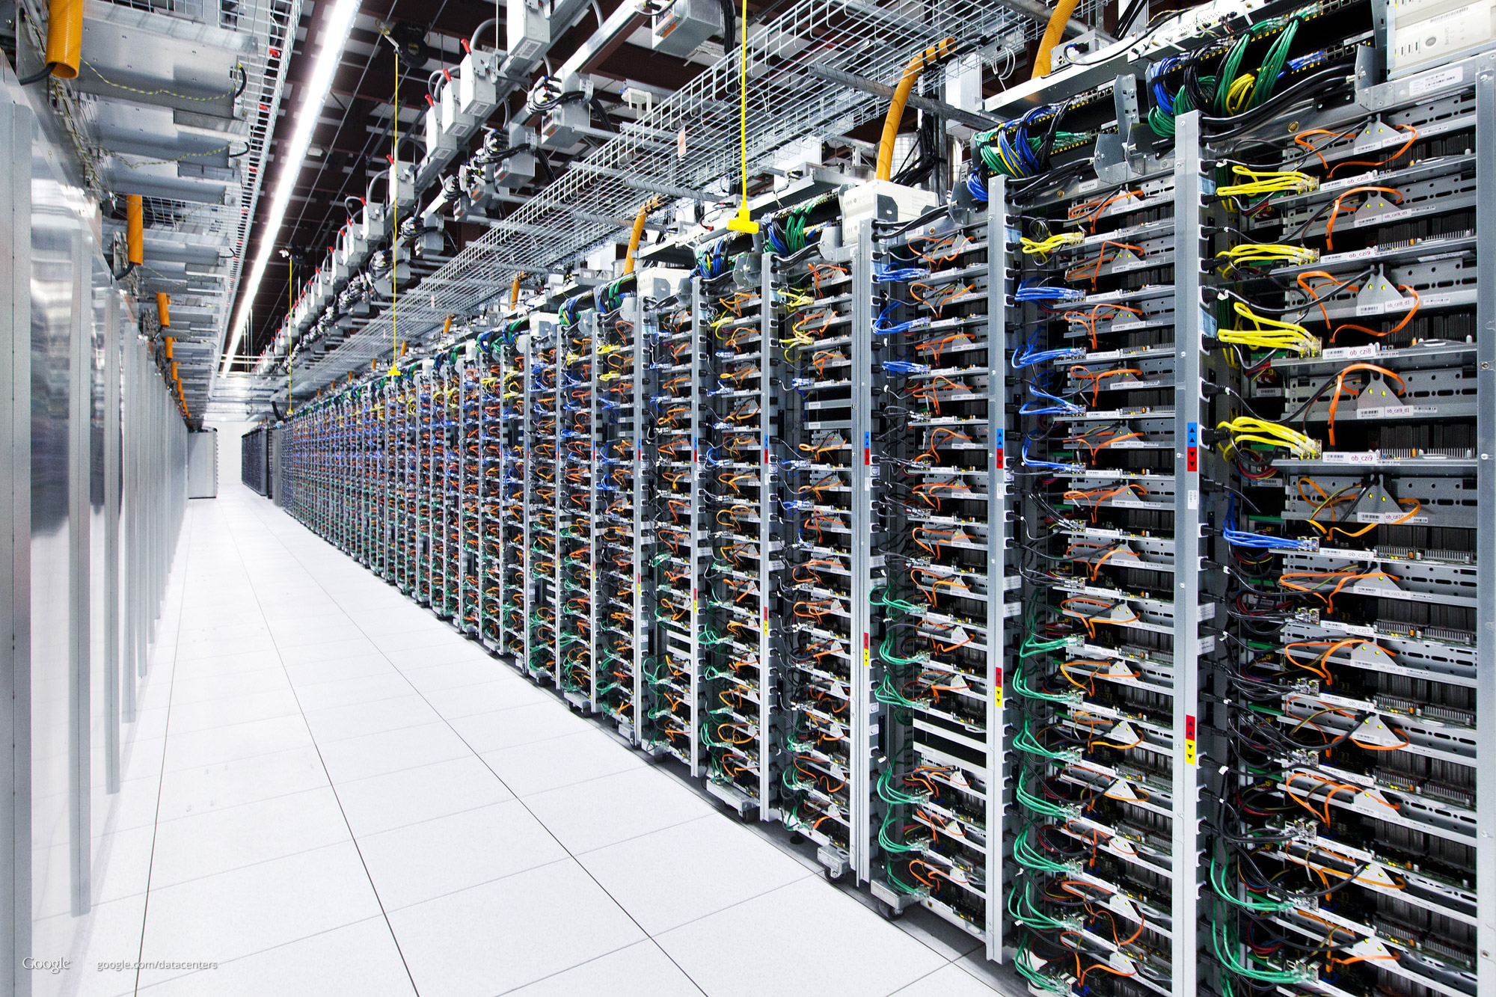
What does “Outsource” mean?
These large cloud computing data-centers have all the hardware, cooling, etc anyone would ever need in one place, so your company doesn’t have to manage any of it.
Clients access “The Cloud” over a network.

Slide 5
What is a cloud? 5 Characteristics
Self-Service: Users can access it at any time without talking to people!
Broad Network Access: All resources are available over a network. (You know, like the internet)
Resource Pooling: The computing resources owned by the provider, can serve multiple customers at once, and reassign resources between these users dynamically.
Elasticity: Based on user demands, resources are assigned/reassigned dynamically.
Measured Service: The provider keeps tabs on the computation and data-storage it’s users use.

Slide 6
Infrastructure as a Service (IaaS)
They do whatever…. wherever.
Clouds usually virtualize their environments.
They use Virtual Machine Monitors (also known as hypervisors) to create multiple virtual machines on their hardware.
Users can choose what operating systems, software, and services to run on their virtual machines.
Because of the virtual environment, multiple operating systems can even exist on the same hardware. (and move between hardware)

Slide 7
Virtual Machine Migration If a computer needs maintenance at cloud HQ...
Problems with this?
Virtual Machines are decoupled from physical hardware!
If maintenance on a computer is required, VMs can move themselves between hardware, and don’t have to be shut down during maintenance.
They pause the virtual machine, copy all memory files and configuration to a new computer, then resume execution there on the new hypervisor (VMM)
Sadly this can cause a noticeable pause in execution as files and config are copied over!

Slide 8
Seamless Live Migration
How?
The VM has to pause to move, but if the memory files are copied ahead of time, this pause can become unnoticeable. This is called seamless live migration.
Begin copying memory files while the VM is still running. (This is called pre-copy memory migration)
Most memory files aren’t written to very often, so only some will have to be re-copied during the pause.
Since the pause is so short… no one will notice. Hopefully.

Slide 9
Checkpointing (Also known as snapshotting)
How?
You can pause a virtual machine while it’s running, what else can you do?
Since you can pause, if the virtual machine is mucked up somehow, you can roll-back to a copied previous state the machine was in.
Copy the files (not all at once but as they’re written) so you can create a snapshot of the running VM.
Only do this as files are written/when necessary, which prevents a huge pause if they were to all be copied at once.

Slide 10
Case Study:
VMware

Slide 11
VMware
VMware Inc. was founded in 1998.
Their Goals:
To bring virtualization to the x86 architecture.
To bring virtualization to the personal computer.
Their first product, VMware Workstation, a Type 2 Hypervisor, was released in 1999 for Linux and Windows.

Slide 12
VMware Workstation
3 Criteria for x86 Virtualization:
Compatibility - Identical Environment
Performance - Low Overhead
Isolation - VM actions separate from Host OS
But there were problems with implementation...
Notes:
not virtualizable, many I/O devices, multiple versions and backwards compatibility for x86 architecture.

Slide 13
x86 Virtualization
3 Methods for VMM Virtualization:
Trap-and-Emulate
Paravirtualization
Dynamic Binary Translation
VMware’s VMM used both trap-and-emulate and dynamic binary translation.
Using both allows the VM to run at near native speeds.

Slide 14
x86 Virtualization
Software Fault Isolation:
Used to protect the VMM from software in the virtual environment.
Can increase run-time overhead.
VMware Workstation uses Hardware Fault Isolation using memory address space.

Slide 15
The Role of the Host OS
VMware Workstation Hosted Architecture Consisted of 3 Independent Components:
VMX (User Space Program)
VMX Driver (Small Kernel-Mode Device Driver)
VMM (Software for Multiplexing)

Slide 16
Virtual Hardware Platform
Virtual Hardware Consists of:
Multiplexing: Configuration of the hardware to be used directly by the VM.
Emulation: Exportation of the software simulation of selected hardware components.
Emulation of devices split two ways:
Front-End - Visible to the Virtual Machine.
Back-End - Interacts with the Host OS.
Hardware-Independent Encapsulation

Slide 17
Evolution of VM workstation
the introduction to Intel VT-x and AMD
two phase
first phase 2005 to eliminate the need paravirtualization or binary translation
second phase 2007 provide hardware support in the MMU in the form of nested page tables.
the goal optimizations for selected guest operating systems.

Slide 18
Nest Virtual Machine
The idea of having a virtual machine run a virtual machine.
still in the early stages currently used for debugging hypervisors and test software on different scales .
https://www.ravellosystems.com/
https://www.youtube.com/watch?v=6vj-ObZTwhA

Slide 19
Researches on VM Cloud Computing
Two organizations
Virtual Execution Environments (VEE)
ACM Symposium on Cloud Computing (SOCC)

Slide 20
Researches on VM Cloud Computing
The VEE focus on the VM and system programing side while the
SOCC focuses on Cloud Computing
both organizations have yearly gathering where researchers present their ideas
http://conf.researchr.org/home/vee-2016
http://conf.researchr.org/home/vee-2016

