Slide 1
Deadlocks

Slide 2
What is a Deadlock
“A set of processes is deadlocked if each process in the set is waiting for an event that only another process in the set can cause.”

Slide 3
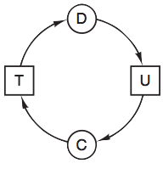
Detection
“Is this system deadlocked, and if so, which processes are involved?”
The Ostrich Algorithm
Hope one of the processes times out and lets the other continue
Deadlock Detection With Single Resource Type
Construct a resource graph looking for a cycle
Deadlock Detection With Unique Resources
Existing resource vector, available resource vector, current allocation matrix, and the request matrix
Recovery
Rollback and Terminating processes
Notes:
Don’t forget to introduce Michael in the next slide

Slide 4
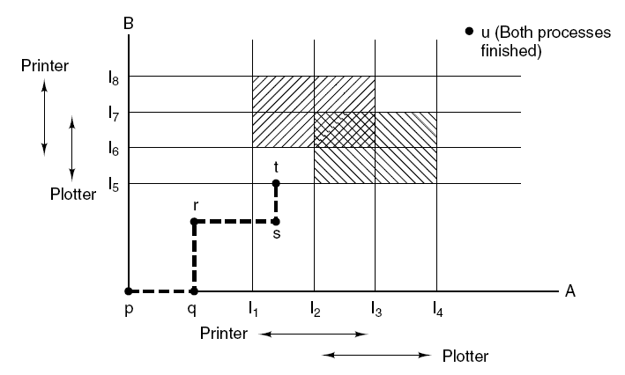
Avoidance
Banker’s Algorithm:
Scheduling algorithm using processes’ Max, Allocated, and Available resources to avoid unsafe memory states. Not practical.
Safe State
A scheduling order allows every process to run til exit while requesting max resources.
Unsafe State
No ordering allows each process all necessary resources. Not a deadlock state.
Notes:
Banker's algorithm created by Dijkstra, our favorite.
Essentially the banker's algorithm is about making sure a system does not run out of resources. It analyzes the resource safety of a process based on three main factors - the process’ maximum required resources, its allocated resources, and the total amount of available resources in the system.
The entire goal is to keep all the processes in a safe state allowing every process to exit successfully even if they allocate their maximum number of resources.
The unsafe state is when there isn’t a way for a process to allocate enough resources to finish and thus the banker's algorithm tries to avoid it.
The limitation of the bankers is that the necessary process information - like the total maximum number of resources the process might ever need is often unavailable.
And here is Trevor on the subject of Prevention.

Slide 5
Prevention
Mutual-Exclusion Condition
Avoid assigning a resource and limit claiming processes
Hold-and-Wait Condition
Programmer specifies resources needed by a job
Requester temporarily releases held resources
No-Preemption Condition
Virtualize resource to allow forcible removal
Spool printer output to disk and only printer daemon printer access
Circular Wait Condition
Limit Process to one resource at a time
Global number for each resource
Notes:
If we were to go back to the four conditions stated by Coffman and others that are required for a deadlock to occur, if we can eliminate one of them, couldn’t this prevent deadlocks? If not, weakening them in a way will lower the chance of a deadlock.
This is when a resource is only available to one process.
Avoid assigning a resource unless it is absolutely necessary, and try to limit the number of processes that can claim the resource. This method helps but does not completely prevent deadlocks. It reminds me of limiting a user’s input to prevent unnecessary problems.
This is when a process is allowed to request more resources when already holding one or more.
Programmer specifies which resources are needed by a job. Then the resources are reserved until that job finishes using them. This is an extra burden for the programmer and wastes resources, but it does eliminate deadlocks.
The program requesting resources temporarily releases all of its held resources, then requests all of the resources it needs.
This is when a resource cannot be forcibly removed from a process without the process itself initiating it.
Some resources can be virtualized to allow forcible removal, spooling printer output to the disk and allowing only the printer daemon access to the real printer
Eliminates deadlocks involving the printer though it does create potential for deadlocks over disk space. Though a large disk space would make it unlikely. However this does not work for all resources. For example, records in databases or tables inside the operating system must be locked to use.
This is the actual chain where there lies a cycle which two processes are wanting resources held by the other.
Why not simply limit the process to hold only one resource at a time? Well, this would sometimes break the deadlock but will not work for large processes.
Use global number for each resource and they can only be requested in order. This makes it so only one process can request the resource it needs since one resource is always higher up on the ordered list. Therefore, the process holding the highest resource will either finish, or use another higher ordered resource. The big fix is that the process holding the highest ordered resource will not be requesting anything below it, eliminating the possibility of a deadlock. The only problem with this method is finding an order that satisfies everyone.
and next is Kim with other types of deadlocks.

Slide 6
Communication Deadlock
Communication Deadlock occurs on networks.
triggers when a set of processes try to communicate with another process.
no process starts any further communication until it receives the communication it is waiting for.
These Deadlocks cannot be prevented by:
ordering the resources.
or avoided by careful scheduling.
Timeouts can be used to break communication deadlocks.
Notes:
Communication Deadlock occurs on networks.
triggers when a set of processes try to communicate with another process.
no process starts any further communication until it receives the communication it is waiting for.
These Deadlocks cannot be prevented by:
ordering the resources.
or avoided by careful scheduling.
Timeouts can be used to break communication deadlocks.

Slide 7
Livelock, Starvation
Livelocks: when processes try to sidestep each other but both of them always take the same direction.
Like a Deadlock, the threads can’t
make further progress, but they are
not blocked - they are simply too
busy responding to resume work.
Starvation when a thread is unable to gain access to shared resources making it stall
Starvation can be avoided by using a first come, first
served resource allocation policy.
Notes:
Livelocks happens when a thread acts in response to the action of another thread and the other threads actions are in response to yet another threads action.
Like a Deadlock, the threads can’t make further progress, but they are not blocked - they are simply too busy responding to resume work.
Starvation describes a situation where a thread is unable to gain regular access to shared resources and is unable to make progress
Starvation can be avoided by using a first come, first served resource allocation policy.
Transition to Aaron with the video, summary and code.

Slide 8
Video Explaining Deadlocks
Original Video Created by 4 horsemen

Slide 9
Summary
Deadlocks prevent processes from moving forward.
Only occur when all four conditions are met
There are several strategies to dealing with them:
Detecting.
Avoiding them.
Preventing them.
Similar problems like the Livelock and Communication Deadlock:
Much more difficult to detect.
Extremely hard to fix.
Notes:
Deadlocks prevent processes from moving forward. This is a very large problem.
Only occur when all four conditions are met, Mutual-Exclusion Condition, Hold-and-Wait Condition, No-Preemption Condition, and Circular Wait Condition
There are several strategies to dealing with them:
Detecting. Finding them once they occur and then terminating the preces.
Avoiding them. Trying to never get into a deadlock by predicting the future. This is not practical because there are always variables you do not know beforehand.
Preventing them. By writing programs so that all four of the Deadlock conditions can never be met simultaneously. This is the best way to avoid the problems of deadlocks.
Similar problems like the Livelock and Communication Deadlock: are
Much more difficult to detect.
Extremely hard to fix.
next is our code which visually represents a deadlock by displaying a resource allocation graph changing as the process and resources change.

Slide 10
Works Cited
Code: https://github.com/baocin/DeadlocksGroupProject
Original Video: https://www.youtube.com/watch?v=4KPEzu92ZWI
Our Video: https://www.youtube.com/watch?v=iBq5gxmQPj4&feature=youtu.be
Textbook:
Tanenbaum, Andrew S. Modern Operating Systems. Boston: Pearson, 2015. Print.

Slide 11
Thank you for your attention

