Slide 1
Page Replacement Algorithms
Memory Management

Slide 2
Optimal Page Replacement
The label for each page in memory is labeled with the number of instructions that will be executed before that page is first referenced.
Replace the page with the highest number: i.e. postpone as much as possible the next page fault.
The OS can’t look into the future to know how long it’ll take to reference every page again .

Slide 3
NRU (Not Recently Used)
3 variations of NRU:
Variation 1: If the requested page is in memory already, change its used bit as 1, otherwise, execute the following algorithm.
Variation 3: Reset all bits to zero on a regular interval, say 60 times/second.
Variation 4: Keep several bits, say 32 bits, to represent the history of usage of the page. When a page is chosen, it is replaced with the new page and the used bits are cleared, except for the leftmost bit.
Keep one bit called the "used bit" or "reference bit", where 1 => used recently and 0 => not used recently.
Variants of this scheme are used in many operating systems, including UNIX and Macintosh.

Slide 4
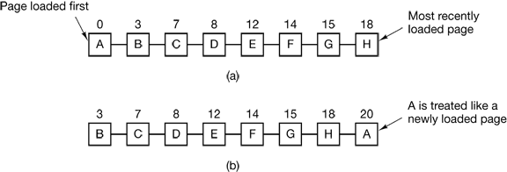
First-In, First-Out The Second-Chance Page Replacement
FIFO, has the pages in a Linked-List
On a page fault, the oldest page will be dropped, while the newest is added to the end
Second chance solves an issue that occurs in FIFO
A Reference bit is used to indicate the page has been used
If 0 the page is replaced
If 1, the R bit is cleared and set to 0 and the load time is updated

Slide 5
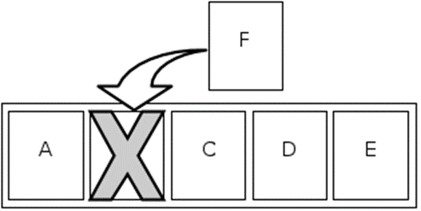
LRU (Least Recently Used)
Discards the least recently used items first.
LRU is implemented by a double linked list.
When a page in the list is accessed, it will be moved from its place to the end of the list.
Downside: Expensive and difficult to implement.
NFU (Not Frequently Used)
Each page has a counter.
After every ‘x’ amount of time, every page that ran during the time interval increments the counter by 1.
Page with lowest counter is swapped out when necessary.
Downside: Does not put into account how long the page ran during the time interval.

Slide 6
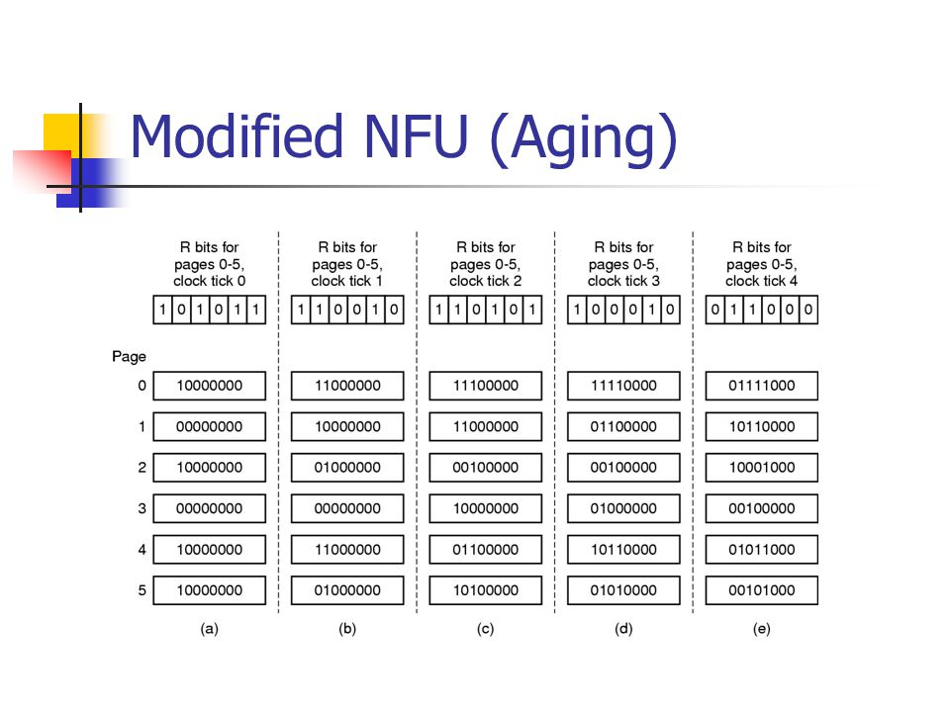
NFU’s Aging Modification
Modification of NFU.
Involves the shifting of reference bits.
Each counter shifts right one bit before the reference bit.
Reference bit then shifts to the left most bit.
If there’s a page fault, the page with the lowest counter will be replaced.

Slide 7
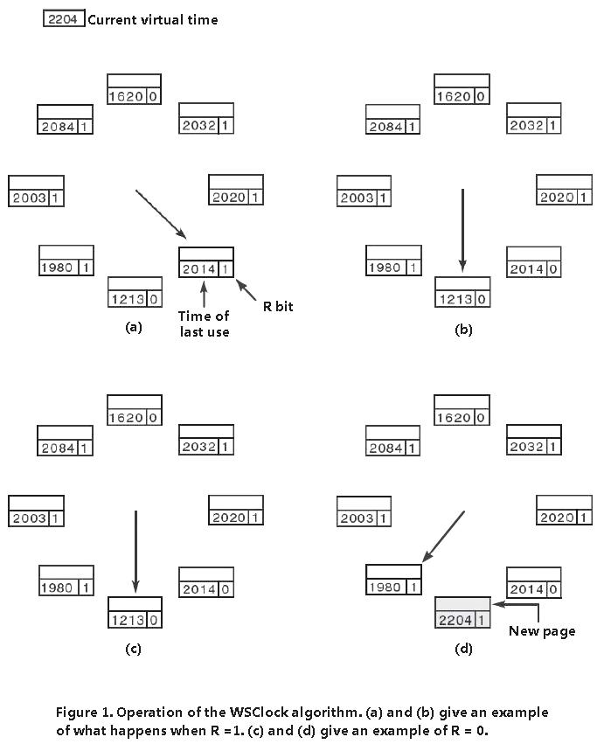
Working Set and WSClock
Pages being used by a process.
If entire WS is in the memory then no page faults.
Algorithm used to make sure working set is in memory.
Time of last used.
WS Clock Algorithm
Improvement of WS page replacement algorithm.
Circular list for each entry.
Time of last used.

Slide 8
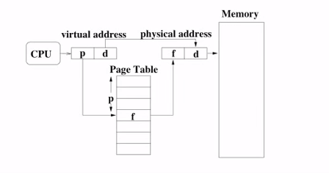
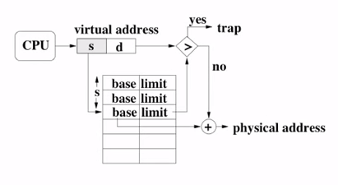
Virtual Memory
Virtual memory is a feature of an operating system (OS) that allows a computer to compensate for shortages of physical memory.
When an instruction is needed by the program it is transferred from virtual memory to physical.
Advantages: Efficient and cheap and programmers can work being aware of just the
LOGICAL MEMORY→ (Combination of physical memory and the hard disk space acting as memory)
Two methods of transferring data:
Paging: Fixed Block Size, Single Address Space and Stored Contiguously.
Segmentation: Variable Block Size, Double Address Space, Stored in Logical Groups.
Paging
Segmentation

Slide 9
Video:

Slide 10
Bibliography
http://www2.cs.uregina.ca/~hamilton/courses/330/notes/memory/page_replacement.htmlAdd your second bullet point here
http://www.liralab.it/teaching/OS/files_current/class_6_10.pdf
http://mcicpc.cs.atu.edu/archives/2012/mcpc2012/lru/lru.html
http://www.moreprocess.com/operating-systems/least-recently-used-lru-not-frequently-used-nfu-aging-page-replacement-algorithm
https://www.cs.princeton.edu/courses/archive/fall10/cos318/lectures/VMPaging.pdf
https://en.wikipedia.org/wiki/Page_replacement_algorithm#Not_frequently_used
https://www.youtube.com/watch?v=Jw8G4GdY-pc
http://www.cs.umd.edu/class/fall2001/cmsc411/projects/virtual/virtual.html
http://www.moreprocess.com/operating-systems/working-set-wsclock-page-replacement-algorithm

